Slide 1
Getting Ready for SQL Server 2025
Upgrade Strategies for Highly Available SQL Server Environments

Slide 2
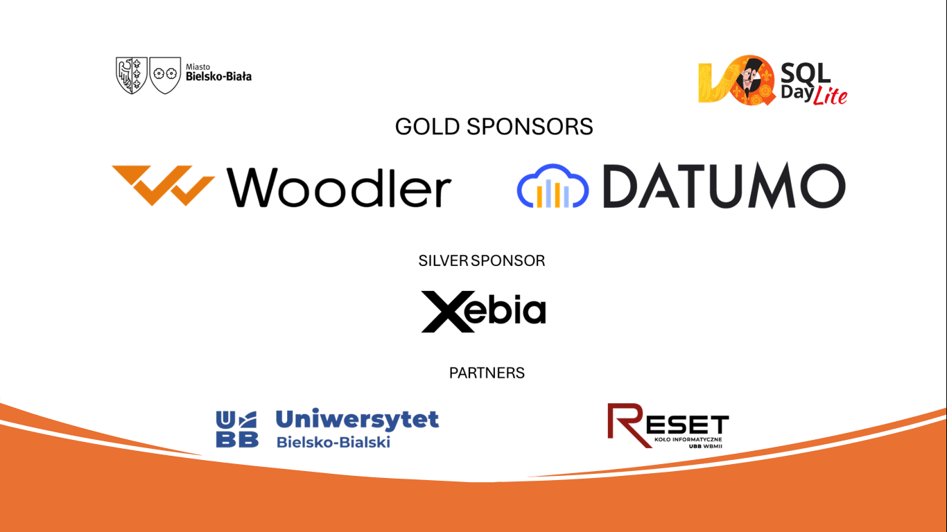

Slide 3


EDWIN
SARMIENTO
Microsoft MVP/Microsoft Certified Master: SQL Server
https://LearnSQLServerHADR.com
edwin@EdwinMSarmiento.com
@EdwinMSarmiento
http://ca.linkedin.com/in/EdwinMSarmiento

Slide 4

database upgrades
are like
IMMIGRATION
in some aspects

Slide 5


Slide 6

I only need to
take care of
MYSELF
Notes:
https://www.flickr.com/photos/strangelukephotography/8446326042

Slide 7


Slide 8

I also have to take care of my
FAMILY
& all of their stuff
Notes:
https://www.flickr.com/photos/nhanusek/243880596

Slide 9
DATABASE UPGRADE & MIGRATION
is no different
Notes:
http://www.photoxpress.com/stock-photos/wood/structure/floor/773027/partner/Xj9qdHIQyb7etVXie4irtPQ9xtZobSzz

Slide 10
Upgrade & Migration Project Timeline
Pre-Upgrade/Migration
Post-Upgrade/Migration
1
2
3
4
Start
End
Actual Upgrade/Migration
Stabilize

Slide 11
Upgrade & Migration Project Timeline
“
It always takes
LONGER
than you expect
- Hofstadter's Law
Pre-Migration
Post-Migration
1
2
3
4
Start
End
Actual Migration
Stabilize

Slide 12
main challenges with
DATABASE UPGRADE & MIGRATION
Notes:
http://www.photoxpress.com/stock-photos/wood/structure/floor/773027/partner/Xj9qdHIQyb7etVXie4irtPQ9xtZobSzz

Slide 13

DESTINATION
are you moving to a physical environment or a virtual one
?
Notes:
http://www.stasmoor.com/images/server-icon.png

Slide 14

server workloads are running in a virtualized environment
81%
Notes:
http://www.stasmoor.com/images/server-icon.png

Slide 15
DESTINATION
on-premise or the cloud
(buying versus renting)
?
Notes:
http://www.stasmoor.com/images/server-icon.png

Slide 16

CONTENT
do we just migrate the databases or include the OS
?
(SQL Server versus SQL Server + Windows)
Notes:
http://www.stasmoor.com/images/server-icon.png

Slide 17
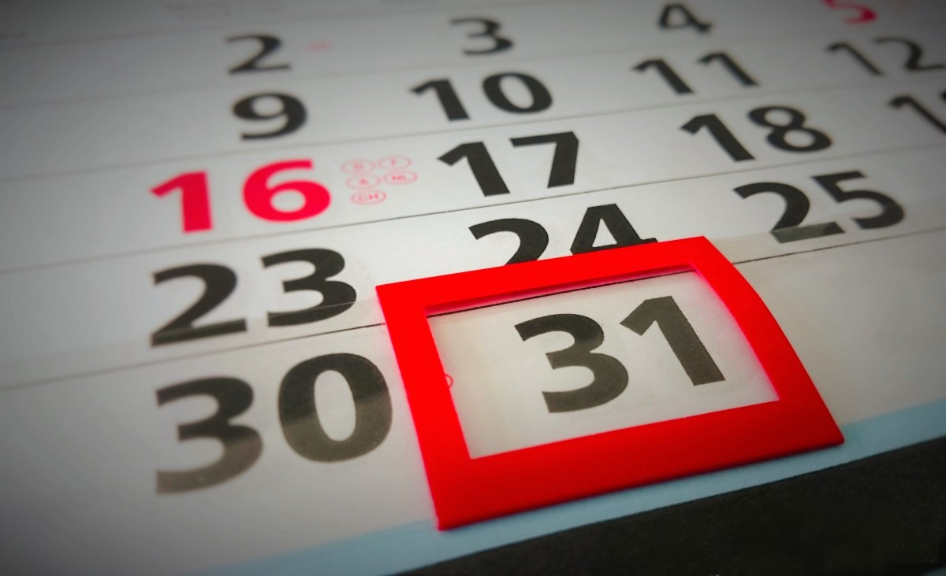
SQL Server & Windows Server
have
DIFFERENT END-OF-LIFE DATES
09-Jan-2024
Windows Server 2019
28-Feb-2025
SQL Server 2019
MAINSTREAM SUPPORT
MAINSTREAM SUPPORT
Notes:
https://www.flickr.com/photos/78749146@N06/13455563693

Slide 18

IDENTIFICATION
will my applications still be able to recognize my database
?
Notes:
http://www.stasmoor.com/images/server-icon.png

Slide 19

Application
Server=SALES; Database=SalesDB;
User Id=ID; Password=PWD;
SQL Server
SQL Server
source
destination

Slide 20
Application
Server=SALES; Database=SalesDB;
User Id=ID; Password=PWD;
SQL Server
SQL Server
source
destination

Slide 21
IDENTIFICATION
will my applications still be able to recognize my database
?
includes application compatibility
Notes:
http://www.stasmoor.com/images/server-icon.png

Slide 22

AVAILABILITY
how much downtime
can I afford
?
(RPO, RTO and SLA)
Notes:
https://cdn4.iconfinder.com/data/icons/time-date-management/512/24hours_available-512.png

Slide 23
AVAILABILITY
how much downtime
can I afford
?
(before, during and/or after)
Notes:
https://cdn4.iconfinder.com/data/icons/time-date-management/512/24hours_available-512.png

Slide 24
BACKUP/COPY/RESTORE
LOG SHIPPING
DATABASE MIRRORING
STORAGE REPLICATION
3rd PARTY TOOLS
how you may have done it
BEFORE
Notes:
https://cdn4.iconfinder.com/data/icons/time-date-management/512/24hours_available-512.png

Slide 25

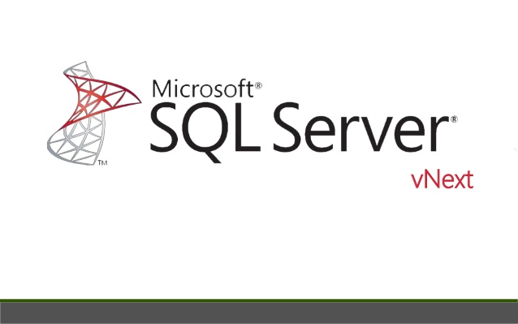
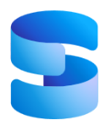

stop
it doesn’t
here
Notes:
https://cdn4.iconfinder.com/data/icons/time-date-management/512/24hours_available-512.png

Slide 26
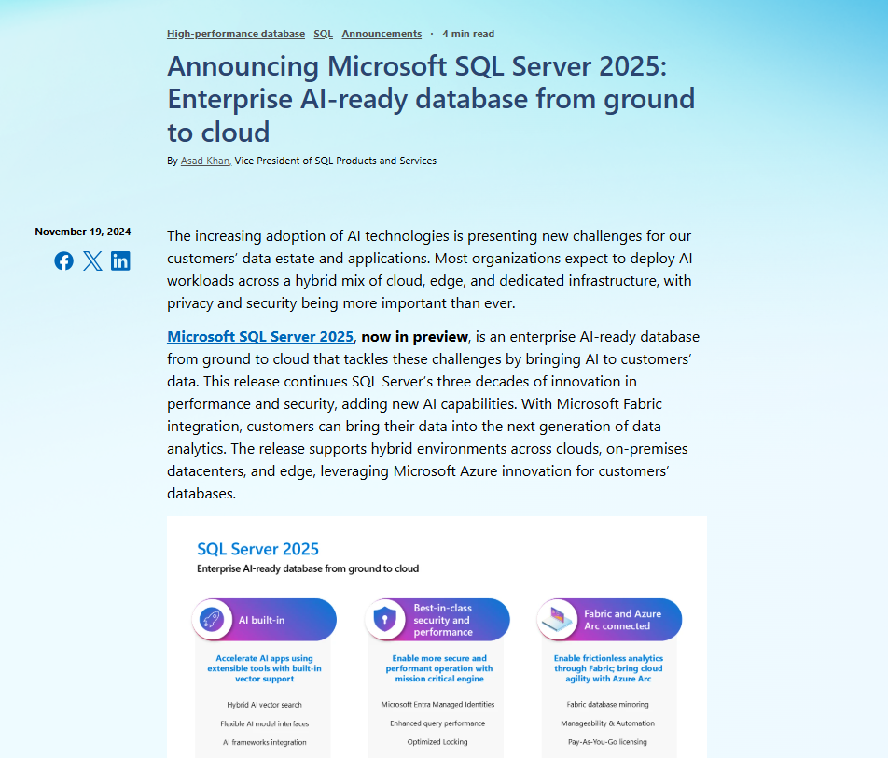
Notes:
https://cdn4.iconfinder.com/data/icons/time-date-management/512/24hours_available-512.png

Slide 27
always
these will be a
part of IT operations
Notes:
https://cdn4.iconfinder.com/data/icons/time-date-management/512/24hours_available-512.png

Slide 28

we need to prepare a
path
to get to our next destination

Slide 29
?
how I prepare for
UPGRADE &MIGRATION

Slide 30
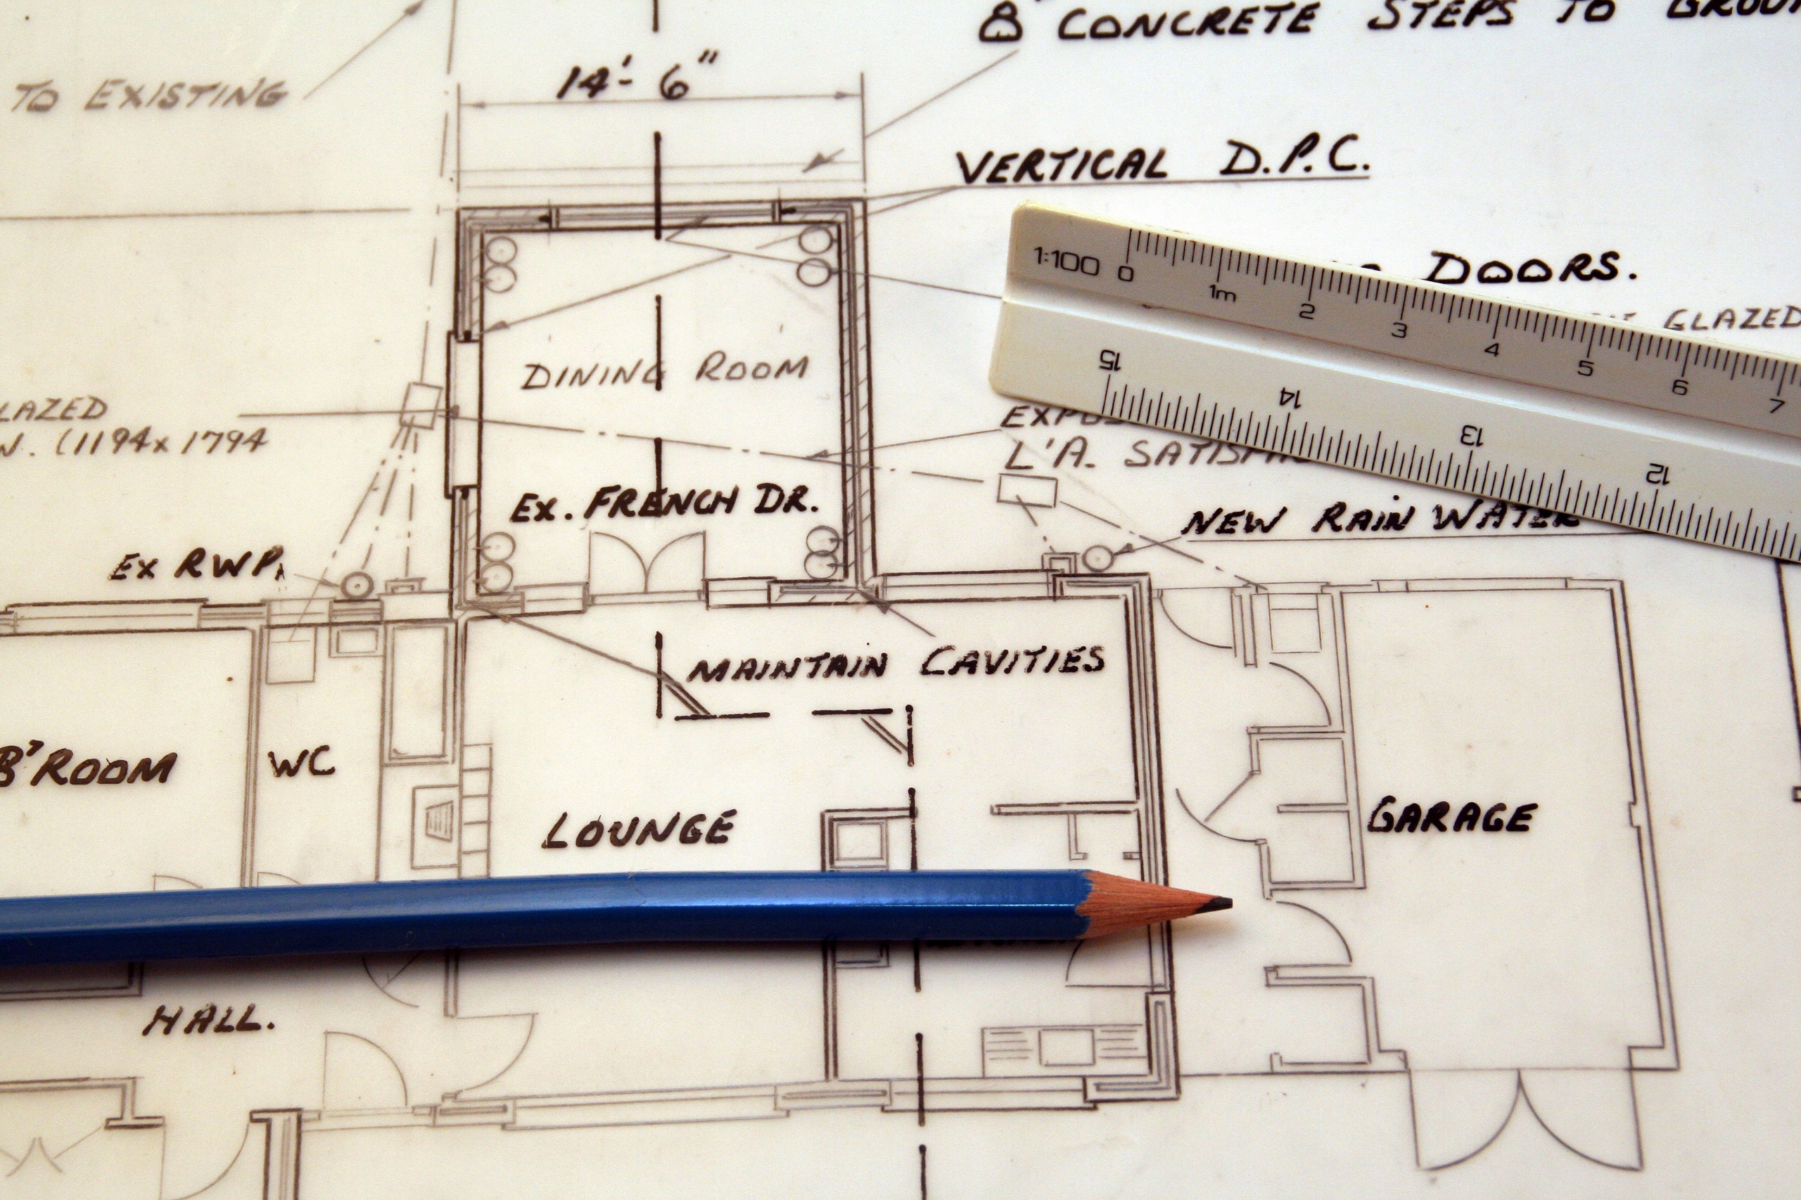
failing to PLAN is planning to FAIL
Notes:
http://www.photoxpress.com/stock-photos/wood/structure/floor/773027/partner/Xj9qdHIQyb7etVXie4irtPQ9xtZobSzz

Slide 31
DESTINATION
CONTENT
IDENTIFICATION
AVAILABILITY

Slide 32
?
WHAT IS MY GO-TO STRATEGY
FOR UPGRADING & MIGRATING
SQL SERVER HIGH AVAILABILITY SOLUTIONS

Slide 33
SIDE-BY-SIDE
TO MINIMIZE RISK & DOWNTIME
*if you want to upgrade the OPERATING SYSTEM as well

Slide 34


upgrading FAILOVER CLUSTERED INSTANCES
SQL Server
SQL Server
backup/copy/restore
log shipping
database mirroring
Windows Server 2025 + SQL Server 2025
prior to SQL Server 2016

Slide 35
upgrading FAILOVER CLUSTERED INSTANCES
SQL Server
SQL Server
Distributed AG
Read-scale AG
(SQL Server 2017)
Windows Server 2025 + SQL Server 2025
SQL Server 2016 and higher

Slide 36
upgrading FAILOVER CLUSTERED INSTANCES
assume we are only doing SQL Server upgrade in-place
IN CASE YOU
INSIST
(IN-PLACE UPGRADE)
SQL Server
2-node cluster
Windows Server 2022 running
SQL Server 2016

Slide 37
upgrading FAILOVER CLUSTERED INSTANCES
FCI Manual Failover
Step 1:
On standby node, install prerequisites and upgrade shared features
Reboot, if prompted
Step 3:
On old active node, install prerequisites and upgrade shared features
Reboot, if prompted
SQL Server
Step 2:
Fail over to the upgraded node

Slide 38
upgrading FAILOVER CLUSTERED INSTANCES
Step 4:
Upgrade to
SQL Server 2025
on inactive node
Step 5:
Upgrade to
SQL Server 2025 on active node
SQL Server 2025
SQL Server
SQL Server 2025
*remove FCI from Cluster Group
Possible Owners
Step 6: Setup performs the failover
(or you can manually failover before upgrading the active node)

Slide 39
upgrading AVAILABILITY GROUPS
SQL Server
SQL Server
SQL Server
SQL Server
backup/copy/restore
log shipping
Windows Server 2025 + SQL Server 2025
prior to SQL Server 2016

Slide 40
upgrading AVAILABILITY GROUPS
SQL Server
SQL Server
SQL Server
SQL Server
Distributed AG
Windows Server 2025 + SQL Server 2025
SQL Server 2016 and higher

Slide 41
upgrading Log Shipping
Step 1: Upgrade secondary instance
*decide whether or not to disable all of the log shipping jobs before upgrading
Notes:
41

Slide 42

upgrading Log Shipping
Step 2: Restore logs
Notes:
42

Slide 43
upgrading Log Shipping
Step 3: Upgrade primary instance
Notes:
43

Slide 44
upgrading database mirroring
PRINCIPAL
MIRROR
Step 1: Upgrade MIRROR instance
Step 2: Wait for LOW activity period
Notes:
44

Slide 45
upgrading database mirroring
PRINCIPAL
MIRROR
*Asynchronous
Step 3: Change to SYNCHRONOUS
Notes:
45

Slide 46
upgrading database mirroring
PRINCIPAL
MIRROR
Step 4: Failover to MIRROR
Notes:
46

Slide 47
upgrading database mirroring
MIRROR
PRINCIPAL
Step 5: Change back to ASYNCHRONOUS
*Asynchronous
Notes:
47

Slide 48
upgrading database mirroring
MIRROR
PRINCIPAL
Step 6: Upgrade the new MIRROR
Notes:
48

Slide 49
failing to PLAN is planning to FAIL
Notes:
http://www.photoxpress.com/stock-photos/wood/structure/floor/773027/partner/Xj9qdHIQyb7etVXie4irtPQ9xtZobSzz

Slide 50
DESTINATION
CONTENT
IDENTIFICATION
AVAILABILITY

Slide 51
EDWIN
SARMIENTO
Microsoft MVP/Microsoft Certified Master: SQL Server
https://LearnSQLServerHADR.com
edwin@EdwinMSarmiento.com
@EdwinMSarmiento
http://ca.linkedin.com/in/EdwinMSarmiento

